Slide 1
Automatic License Number Plate Recognition System
Submitted in the partial fulfillment for the award of the degree of
BACHELOR OF ENGINEERING
IN
AIML
Submitted by:
NAMAN RAJ YADAV
21BCS11862
Under the Supervision of:
Pulkit Dwivedi
Department of AIT-CSE
DISCOVER . LEARN . EMPOWER

Slide 2
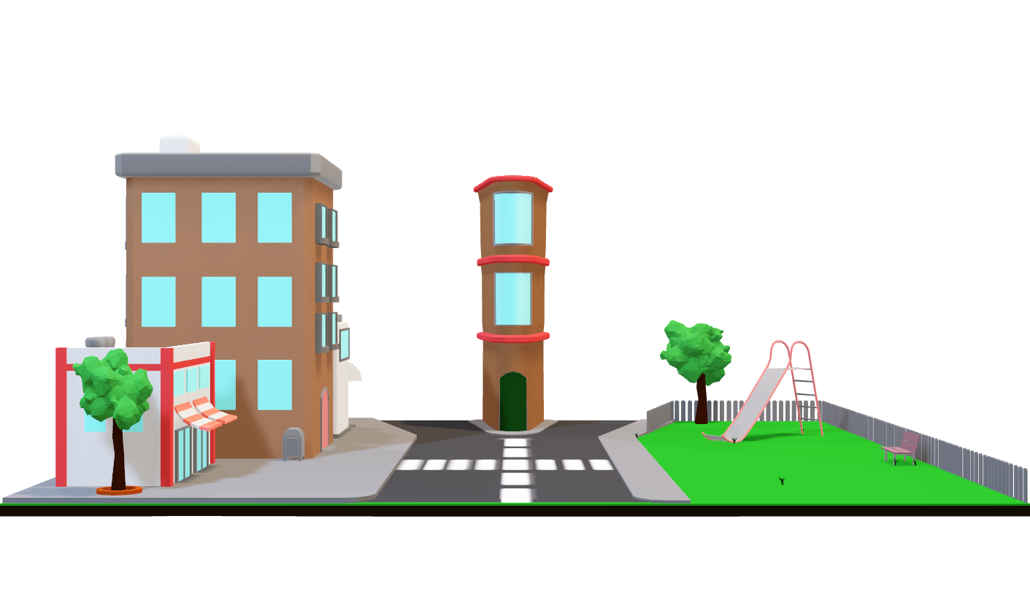

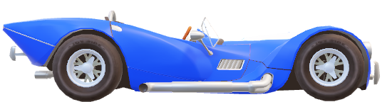
Outline
Introduction to Project
Objectives of the work
Methodology used
Conclusion
References

Slide 3

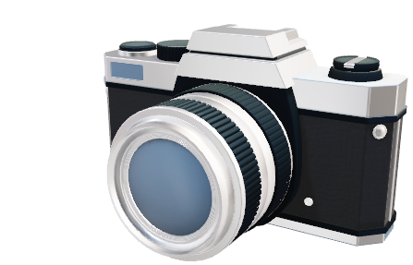
Introduction to Project
Project Focus- This project centers on the development of an advanced Automatic License Number Plate Recognition System (ALPR) .
Technology Fusion- Leveraging the synergy of Deep Learning, Convolutional Neural Networks (CNN), OpenCV, and Python's Keras library, YoloV8, SSD, R-CNN.
Multi-Stage Approach- Encompassing image preprocessing, license plate detection, precise character segmentation, character recognition, and comprehensive testing to ensure accuracy.

Slide 4

Introduction to Project
Real-World Applications- Traffic management, automate toll collection, enhance security, and improve law enforcement operations.
Technological Advancement- It show case the power of modern algorithms to enhance everyday processes and contribute to urban development.
Interdisciplinary Significance- It’s relevance in areas like transportation, urban planning, law enforcement, and more.

Slide 5

Objectives of the Work
Develop advanced ALPR using Deep Learning, CNN, OpenCV, Keras, YOLO V8, and SSD.
Accurately detect and recognize license plate numbers from surveillance images.
Optimize traffic management, law enforcement, and security practices.
Contribute to urban efficiency and advancement.

Slide 6
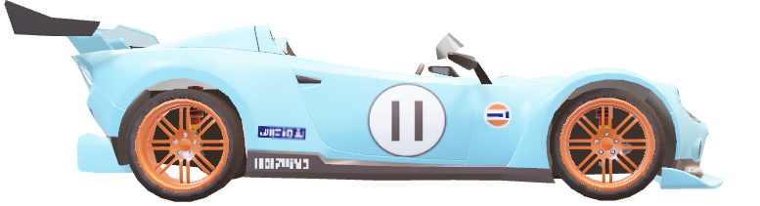
Methodology used
Image Preprocessing: Images captured by surveillance cameras underwent preprocessing to enhance quality and remove noise, ensuring optimal input for subsequent stages.
License Plate Detection (OpenCV): OpenCV was employed to locate license plates within preprocessed images, utilizing pattern recognition techniques for accurate identification.
Character Segmentation (CNN): Convolutional Neural Networks (CNN) were designed using Keras to segment characters within identified license plates, enabling precise extraction.

Slide 7
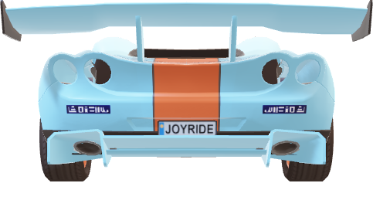
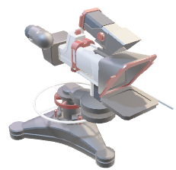
Methodology used
4.Character Recognition (Keras, YoloV8 and SSD): Employing Keras, YoloV8, and SSD, trained models recognized segmented characters, converting them into alphanumeric information.
5.Testing and Optimization: The entire system underwent rigorous testing using diverse datasets, followed by iterative optimization to enhance accuracy and efficiency.
6.Integration and User Interface: The successful system components were integrated, and a user-friendly interface was developed to facilitate real-world deployment.

Slide 8
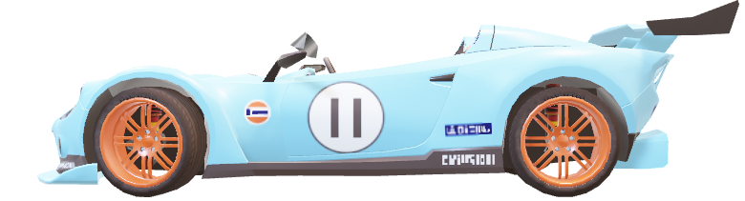
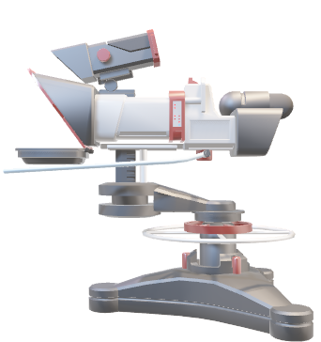
Conclusion
Highlights-
Using Deep Learning, CNN, OpenCV, and Keras, YoloV8, SSD, R-CNN, CNN, an advanced ALPR system has been successfully created.
Prophesying improvements in traffic management and security is accurate license plate detection and recognition.
Demonstrated the potential for interdisciplinary collaboration to spark creative solutions.

Slide 9
Conclusion
Pitfalls-
Encountered difficulties because of the heterogeneity of the dataset and actual environmental conditions.
Continuous algorithm improvement is required to provide reliable performance.
Precision calibration and optimization were needed for complex technology integration.

Slide 10
References
[1] Llorca, R., Gómez, E., & Albiol, A. (2011). "Automatic License Plate Recognition System using a combination of Morphological Operations, statistical features, and Neural Networks." Pattern Recognition and Image Analysis, 170, 125-137.
[2] Amin, K. M., Bhuiyan, M. S. U., & Mihalcik, D. (2015). "A innovative approach for automatic registered plate recognition using SURF and CNN." Pattern Recognition Letters, 68, 261-267.
[3] Zhang, P., Zhou, C., and Xiao, B. (2015). "A hybrid approach to automated automobile registration plate identification based on edge perception and Hough rotation." 126(11), 1813–1819, Optik - the World's Journal for Lighting and Electron Vision.
[4] Wei, D., Ding, S., & Zhou, M. (2015). "A region-based approach for automated vehicle registered plate identification." IEEE Transactions on Intelligent Transportation Systems, 16(4), 1643-1652.
[5] Proença, H., & Martins, P. P. (2013). "Automatic License Plate Detection and Recognition: An Extensive Survey." Pattern Recognition, 46(7), 1934-1952.

Slide 11
THANK YOU

